Slide 1
THE CIRCULAR-FLOW OF ECONOMY

Slide 2
The circular-flow of income model
A visual model of the economy that shows how money flows through markets among different sectors of an economy.
We have considered 5 sectors in an economy,
Households
Firms
Financial sector (Banks)
Government
Foreign sector ( Rest of the world)

Slide 3
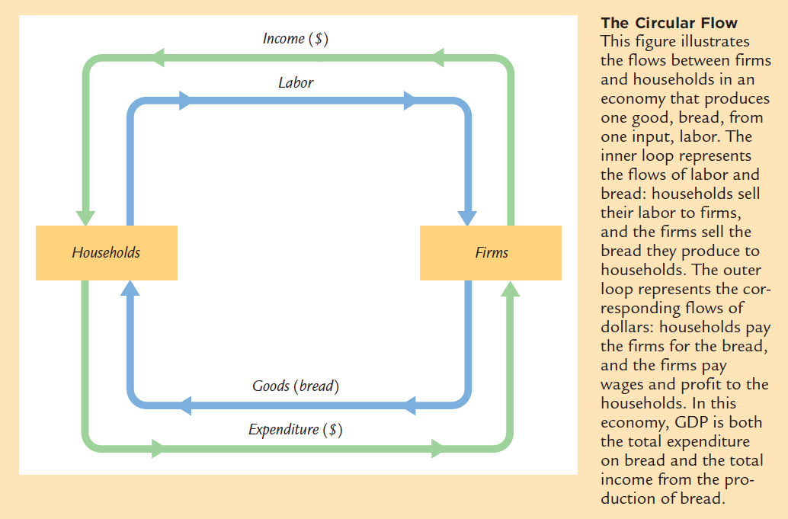
Two Sector Model (Spendthrift Economy)

Slide 4
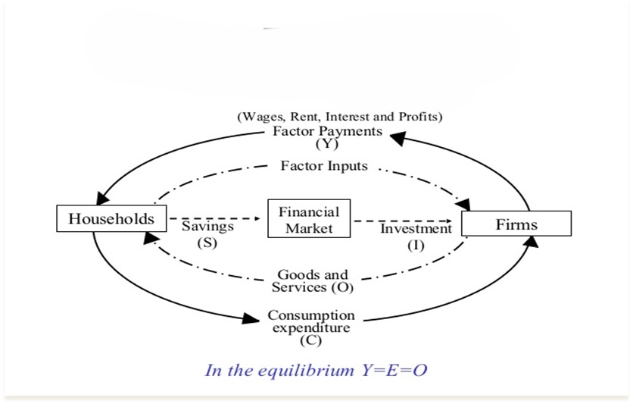
Circular Flow of Income-Three Sector Model

Slide 5
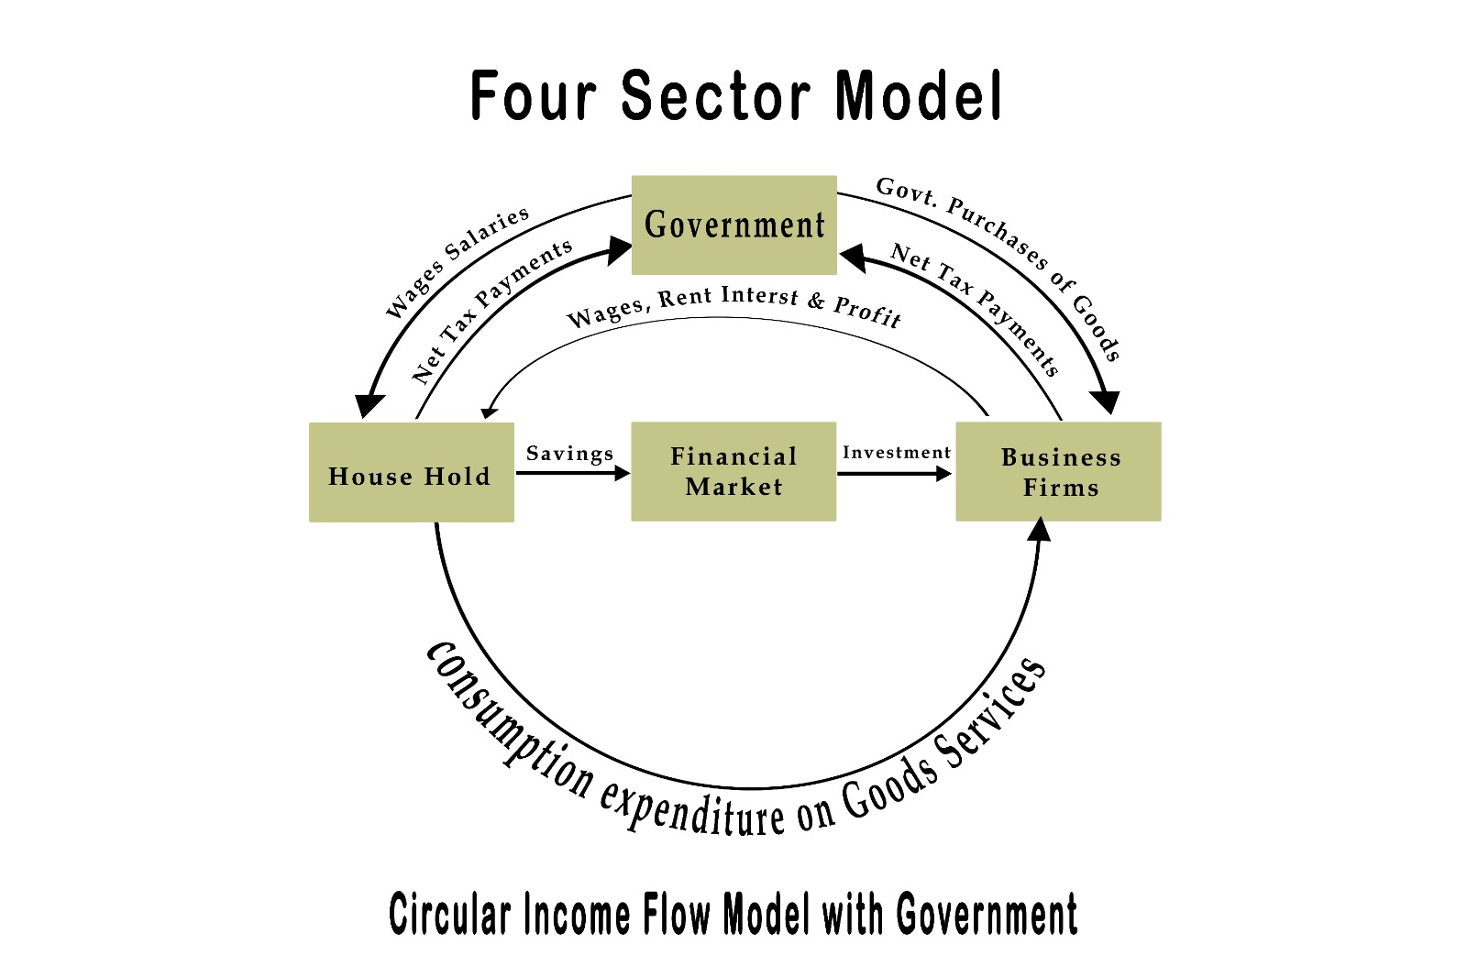

Slide 6
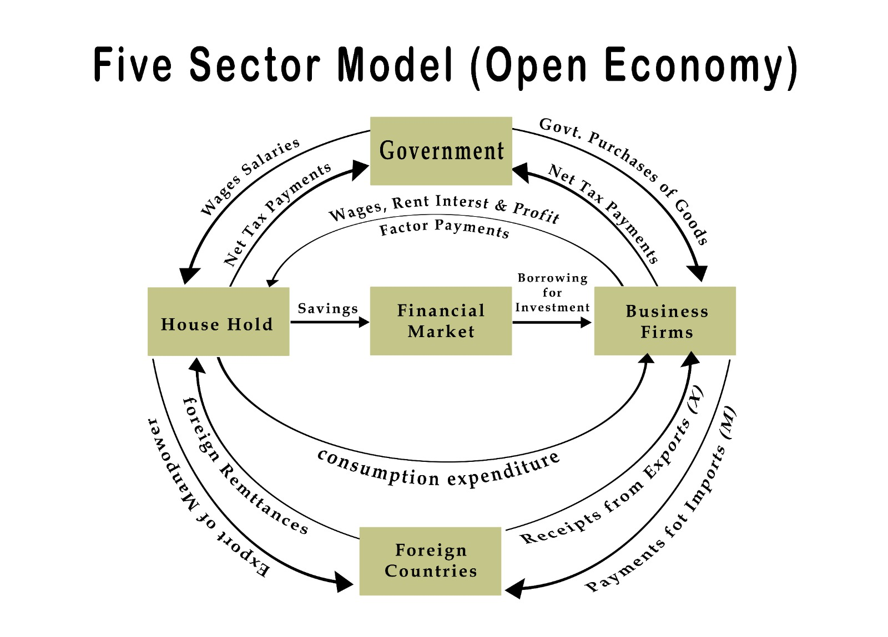

Slide 7
© This presentation is a property of Department of Humanities and Social Sciences, Malaviya National Institute of Technology Jaipur ( Rajasthan) . Reproduction and distribution of the presentation without written permission of department is prohibited.
Thank You

